Slide 1
Example 1-D heat Transfer problem
Buffered Communication

Slide 2
1D-Heat Transfer Problem
Buffered Mode Implementation of exchange operation
Programmer determines the required size of communication buffer space and reserves it in the user space of each MPI process
Buffer space should be set to be equal to or larger than the cumulative buffer size needed by all outgoing MPI_Bsend()’s that can be active at a given time.
Buffer space is then attached to be used by the MPI_Bsend()’s command
Deadlock will be prevented because MPI_Bsend()’s will not block allowing MPI_Recv()’s to be executed.

Slide 3
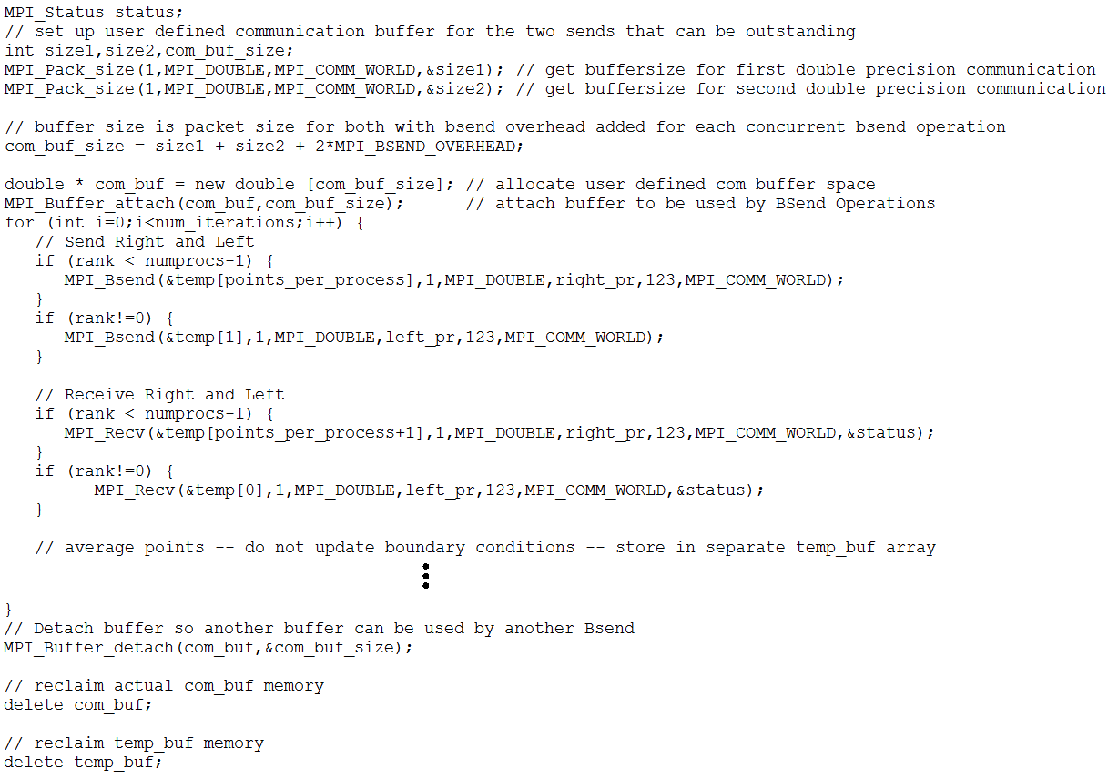
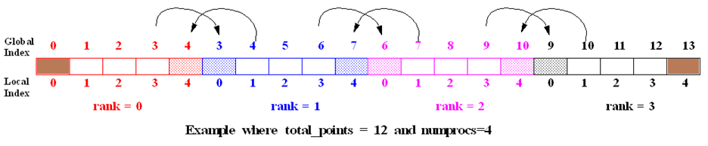

Slide 4
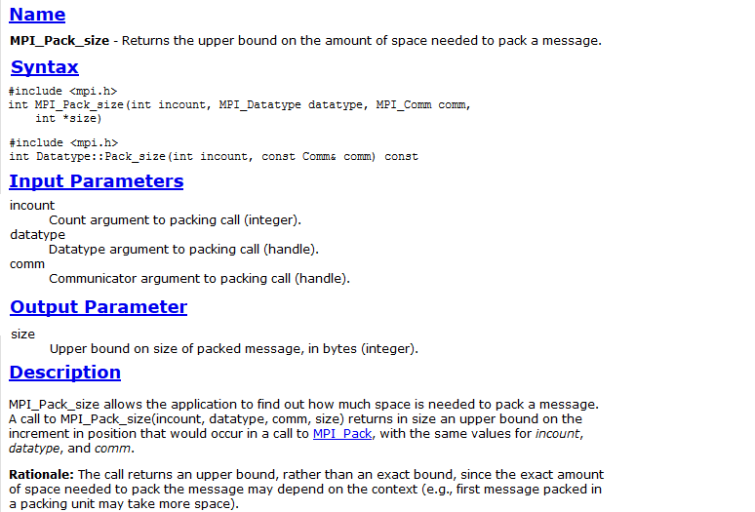

Slide 5
